Slide 1


FRONTEND
WORKSHOP

Slide 2

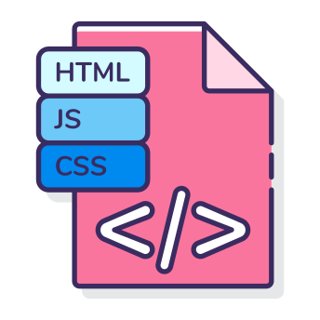



Agenda
01
02
03
Intro to Web
HTML &CSS
Build Session

Slide 3

What is Web Development?
Process of building , creating and maintaining websites over internet
Web: websites or anything that works over the internet.
Development: Building the website from scratch.

Slide 4
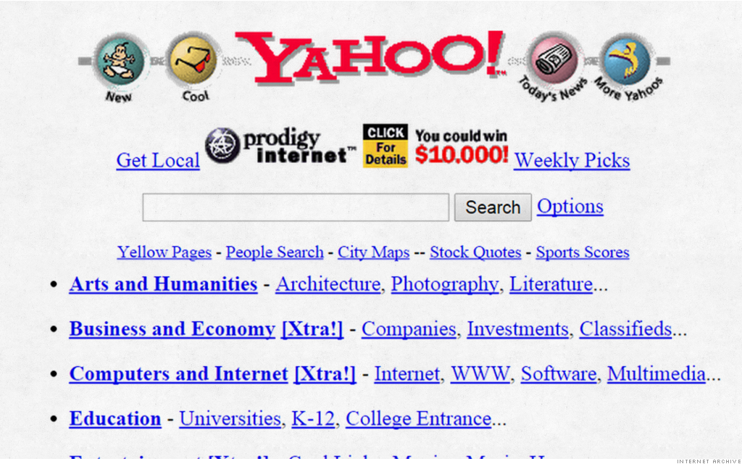
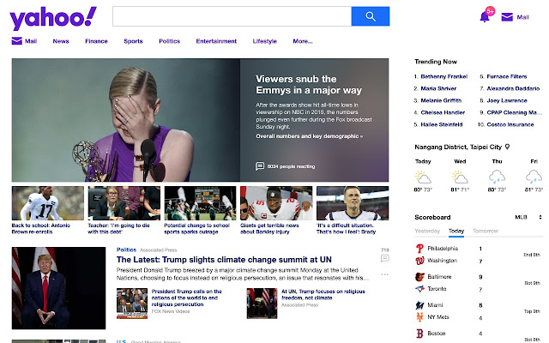
Evolution of Web Development
Website traffic depends on your website’s design
Earlier
Now

Slide 5



Webpage , Web Browser and Website
Webpage:
Document over Internet that contains some content
Website:
Collection of web pages
Web Browser:
Used to view web pages

Slide 6

Client and Server
Client: Requests the server
Server: Responds to client’s request

Slide 7


How web works ?
Hey, I want to watch YouTube.
Sure
Hi server, I have this domain name, can you tell me its corresponding address
Sure
www.youtube.com
93.184.216.34

Slide 8


How web works ?
Here is the address, send me the files
Ok, I am sending files right away!
HTTP request
Here you go, I have rendered the files received ! YouTube is waiting for you.
Thank you , I am going to binge watch series now.
www.youtube.com

Slide 9

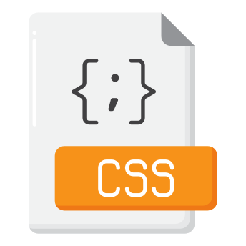

Web development
Front - end
Back- end
HTML
CSS
JS
HTML – Structure of Webpage
CSS – Design of Webpage
JS – Functionality of the page or element

Slide 10
Let’s Learn HTML

